Slide 1

Project Title: Melanoma Detection Using Convolutional Neural Networks on Skin Lesion Images Domain: Healthcare Supervisor: Prof. Ramya Mohan Krishnan
Final Review
Course Code: CS7510
Course Title: Project 2
Register Number: 23MSP3073
Name: Jayanth Kumar
Date: 18th March 2025

Slide 2
Abstract
Skin cancer is one of the most common types of cancer worldwide, with early detection playing a critical role in improving survival rates. Traditional diagnostic methods, such as dermoscopy and biopsy, are time-consuming and require expert dermatologists. In recent years, deep learning has emerged as a powerful tool for automating skin lesion classification, enabling fast and accurate diagnosis. In this project, we leverage pre-trained models, a lightweight convolutional neural network (CNN), to classify skin lesions into seven categories: melanoma (mel), nevus (nv), basal cell carcinoma (bcc), actinic keratoses (akiec), benign keratosis-like lesions (bkl), vascular lesions (vasc), and dermatofibroma (df). The model is trained on the HAM10000 dataset, a well-known benchmark dataset for skin lesion classification. Additionally, we implement a Gradio-based web application that allows users to upload an image and receive real-time predictions in the form of a probability distribution. The proposed system aims to assist dermatologists in early detection and classification of skin lesions, ultimately reducing the diagnostic burden and improving patient outcomes.
Keywords: convolutional neural network, Melonoma, Gradio (web-app)

Slide 3
Introduction
Skin cancer poses a significant global health burden, with millions of new cases diagnosed each year. Among various types, melanoma is the most aggressive and life-threatening, making early detection crucial for effective treatment. Traditional diagnostic techniques involve visual inspection, dermoscopy, and biopsy, which, while effective, require expertise and are often time-consuming. The rise of deep learning and computer vision has introduced automated solutions for skin lesion classification, offering faster and more accessible diagnostic assistance.
Convolutional Neural Networks (CNNs) have shown remarkable performance in medical image analysis, particularly in tasks like skin lesion classification. However, traditional deep learning models are computationally expensive, making them less practical for real-world deployment. To address this challenge, we employ custom CNN, a lightweight deep learning architecture optimized for mobile and edge computing applications.
In this study, we train MobileNet on the HAM10000 dataset, a large collection of dermoscopic images with seven distinct skin lesion types. Given the inherent class imbalance in the dataset, we apply techniques such as data augmentation, class weighting, and focal loss to enhance model generalization. Furthermore, to make the model accessible to a wider audience, we develop a Gradio-based web application, allowing users to upload images, visualize probability-based predictions, and interact with the model effortlessly.
The key objectives of this project include:
Developing an efficient deep learning model for skin lesion classification.
Addressing class imbalance through advanced training techniques.
Deploying a user-friendly Gradio web app for real-time skin lesion classification.
Providing accurate probability distributions to enhance interpretability for dermatologists.
Through this study, we aim to contribute towards AI-assisted dermatology, offering a potential tool for early-stage skin cancer detection and improved diagnostic efficiency.

Slide 4
Problem Statement
Skin cancer, particularly melanoma, is one of the deadliest forms of cancer, and early detection is crucial for effective treatment. However, traditional diagnostic methods rely on expert dermatologists, which can be time-consuming and prone to human error. This project aims to develop an AI-powered deep learning model for automated melanoma classification using skin lesion images. By leveraging Convolutional Neural Networks (CNNs) and advanced image processing techniques, the system will enhance diagnostic accuracy, reduce the burden on healthcare professionals, and enable early detection, ultimately improving patient outcomes.

Slide 5
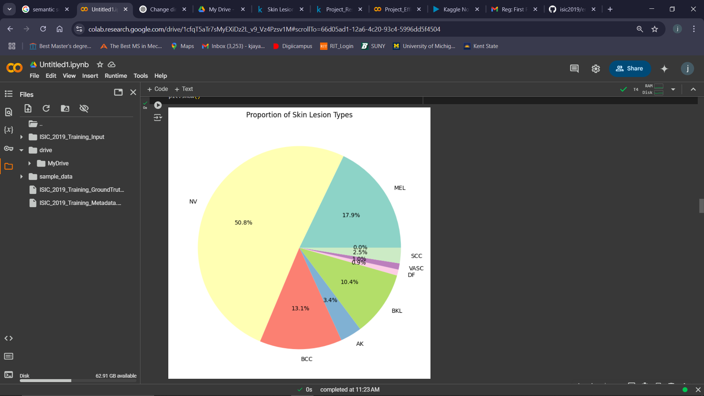
Exploratory Data Analysis
Class Distribution

Slide 6
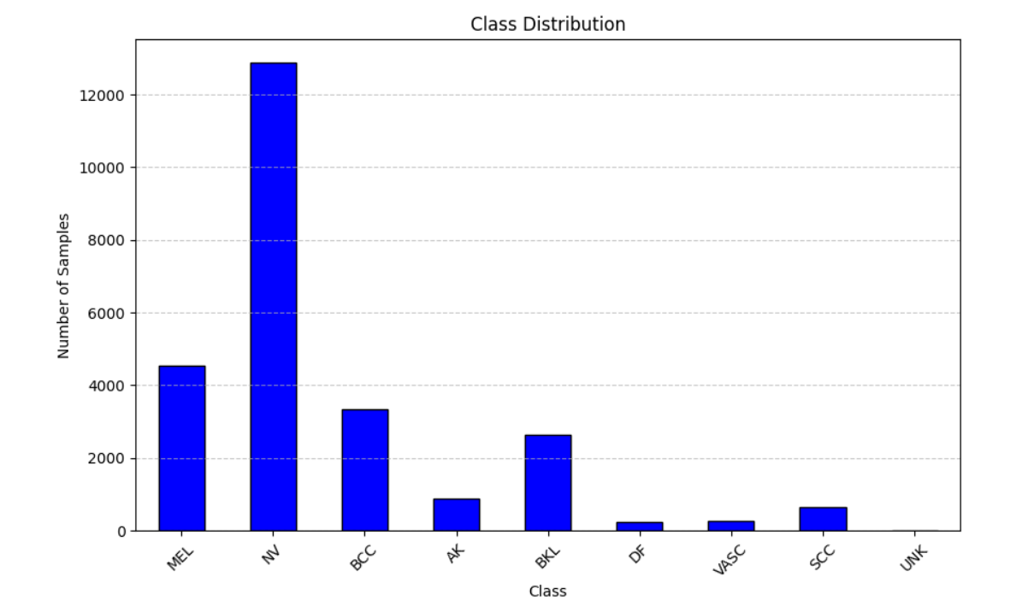
Count of class imbalance:

Slide 7
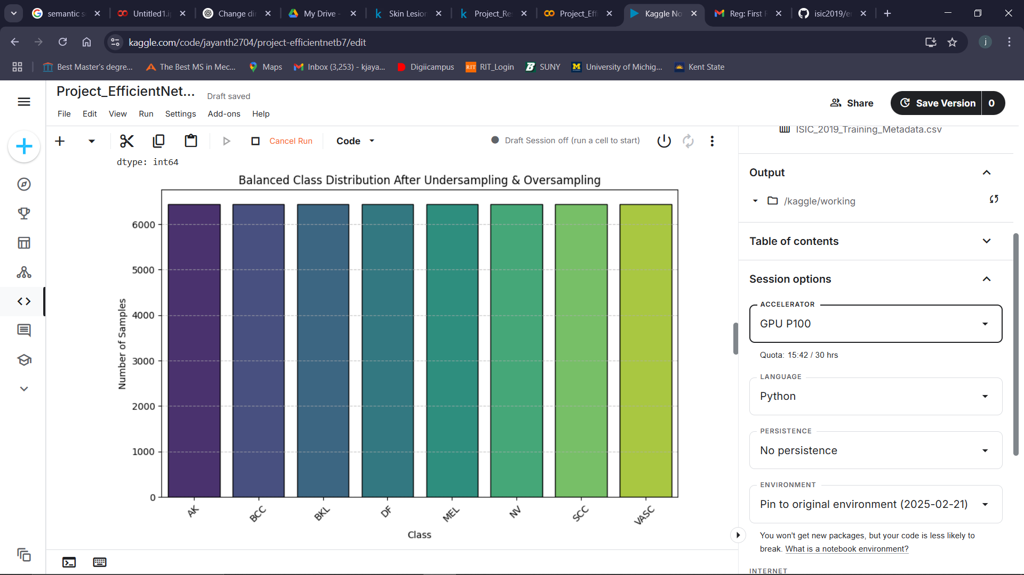
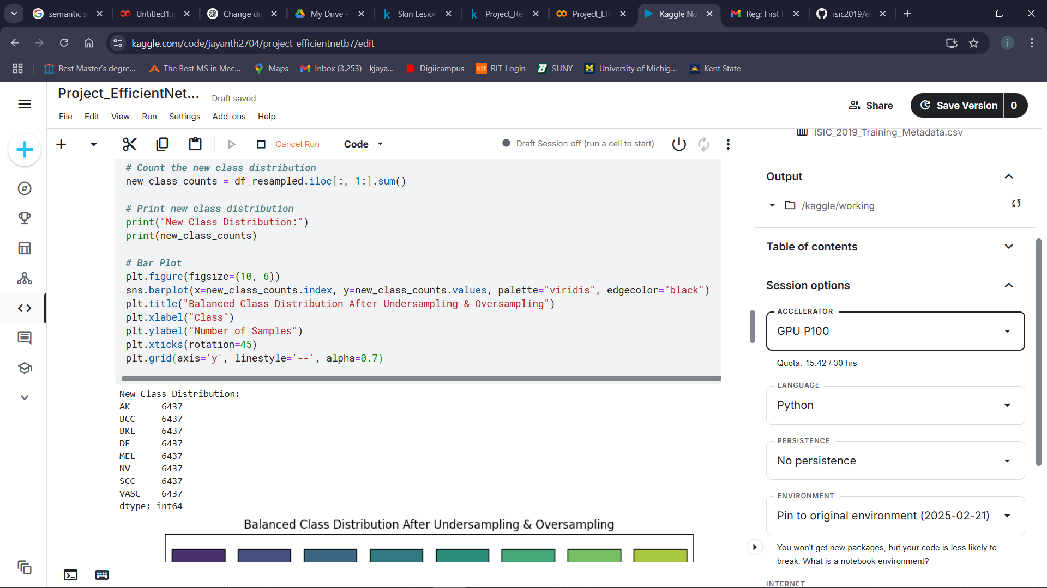
Balanced Classes
7

Slide 8
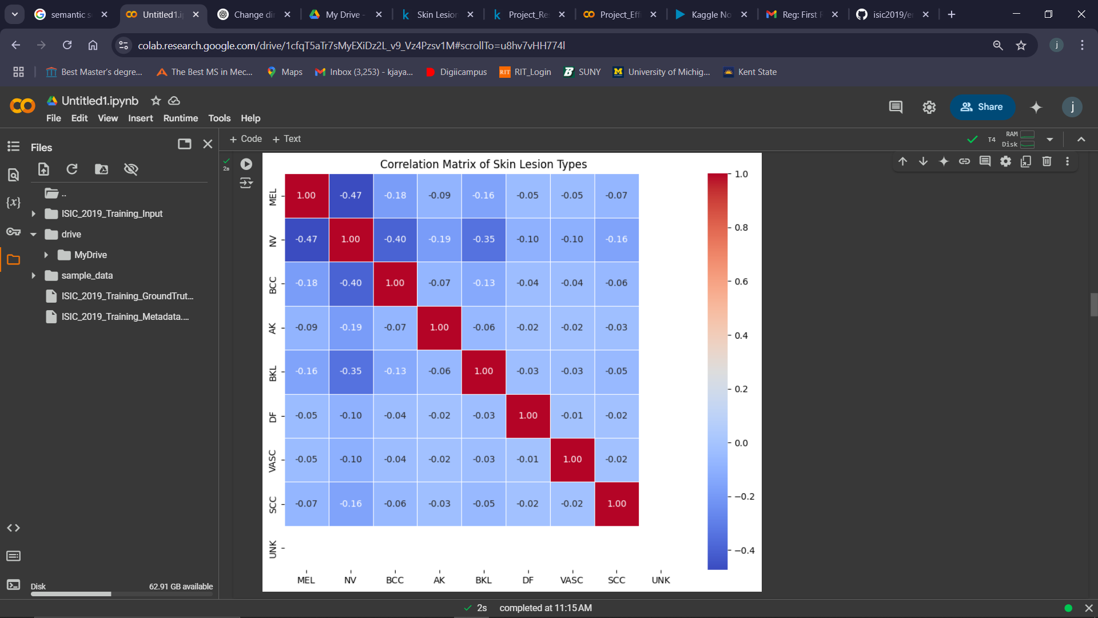
Correlation Matrix
8

Slide 9
Objectives
The objective of this project is to develop a deep learning-based melanoma classification system that can accurately detect and classify skin lesions from dermoscopic images using advanced Convolutional Neural Networks (CNNs). This system aims to assist dermatologists in early melanoma detection, improving diagnostic efficiency and reducing the risk of misdiagnosis.
To achieve this, the project will:
Address Class Imbalance: Since melanoma is rarer than benign lesions, implement class balancing strategies such as weighted loss functions, synthetic data generation (SMOTE), or imbalanced-learn sampling to prevent biased predictions.
Leverage Transfer Learning: Utilize pre-trained models such as EfficientNet-B7 or ResNet-50 and custom CNN to enhance feature extraction, reducing training time and improving model performance
Optimize Computational Efficiency: Select an appropriate model that balances accuracy and computational cost, ensuring feasible training on platforms like Kaggle with limited resources.
Evaluate Performance Using Robust Metrics: Assess the model using accuracy, precision, recall, F1-score, AUC-ROC, and confusion matrices to measure effectiveness across different lesion types.
Compare Model Architectures: Experiment with multiple CNN architectures (EfficientNet, ResNet, MobileNet, etc.) to identify the best-performing model for melanoma classification.
Deploy the Model for Real-World Use (Future Scope): Explore possibilities for integrating the trained model into a web or mobile-based application for dermatologists and healthcare professionals.
This project ultimately aims to develop a highly accurate, efficient, and generalizable deep learning model that can aid in the early detection of melanoma, potentially improving patient outcomes through timely diagnosis and intervention.

Slide 10
Related Work
1. | Skin lesion classification using ensembles of multi-resolution EfficientNets with meta data | Nils Gessert, Maximilian Nielsen, Mohsin Shaikh, RenéWerner, Alexander Schlaefer | Elsevier | 2020 | EfficientNets, SENet, and ResNeXt WSL | 95.16%

Slide 11
2. | Skin lesion classification of dermoscopic images using machine learning and convolutional neural network | Bhuvaneshwari Shetty, Roshan Fernandes, Anisha P. Rodrigues, Rajeswari Chengoden, Sweta Bhattacharya & Kuruva Lakshmanna | Scientific Reports | 2022 | Custom CNN and Pre-trained models | 91.8%

Slide 12
3. | Skin Lesion Classification Using a Deep Ensemble Model | Su Myat Thwin and Hyun-Seok Park | MDPI | 2024 | VGG16, Inception-V3, and ResNet-50 | 93.2%

Slide 13
4. | Skin lesion classification using machine learning approach: A survey | Adnan Afroz; Razia Zia; Andres Ortiz Garcia; Muhammad Umar Khan; Umair Jilani; Khawaja Masood Ahmed | IEEE Xplore | 2022 | Ensemble techniques | 92.48%

Slide 14
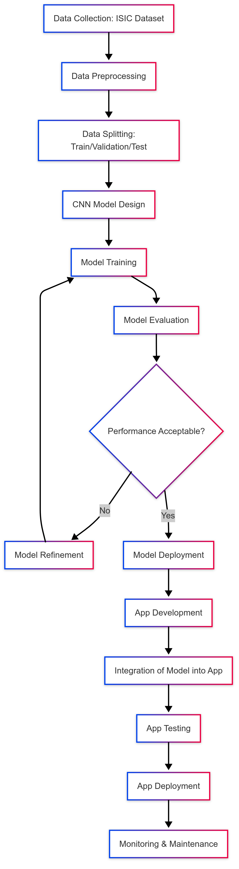
Proposed Methodology

Slide 15
Dataset
Source of the Dataset: Kaggle (Balanced Skin Cancer MNIST:HAM 10000 Dataset)
Link: https://www.kaggle.com/datasets/utkarshps/skin-cancer-mnist10000-ham-augmented-dataset
Observations: 10015 images belonging to 7 classes
8 Classes: Melanoma, Melanocytic nevus, Basal cell carcinoma, Actinic keratosis, Benign keratosis (solar lentigo / seborrheic keratosis / lichen planus-like keratosis), Dermatofibroma, Vascular lesion, Squamous cell carcinoma

Slide 16
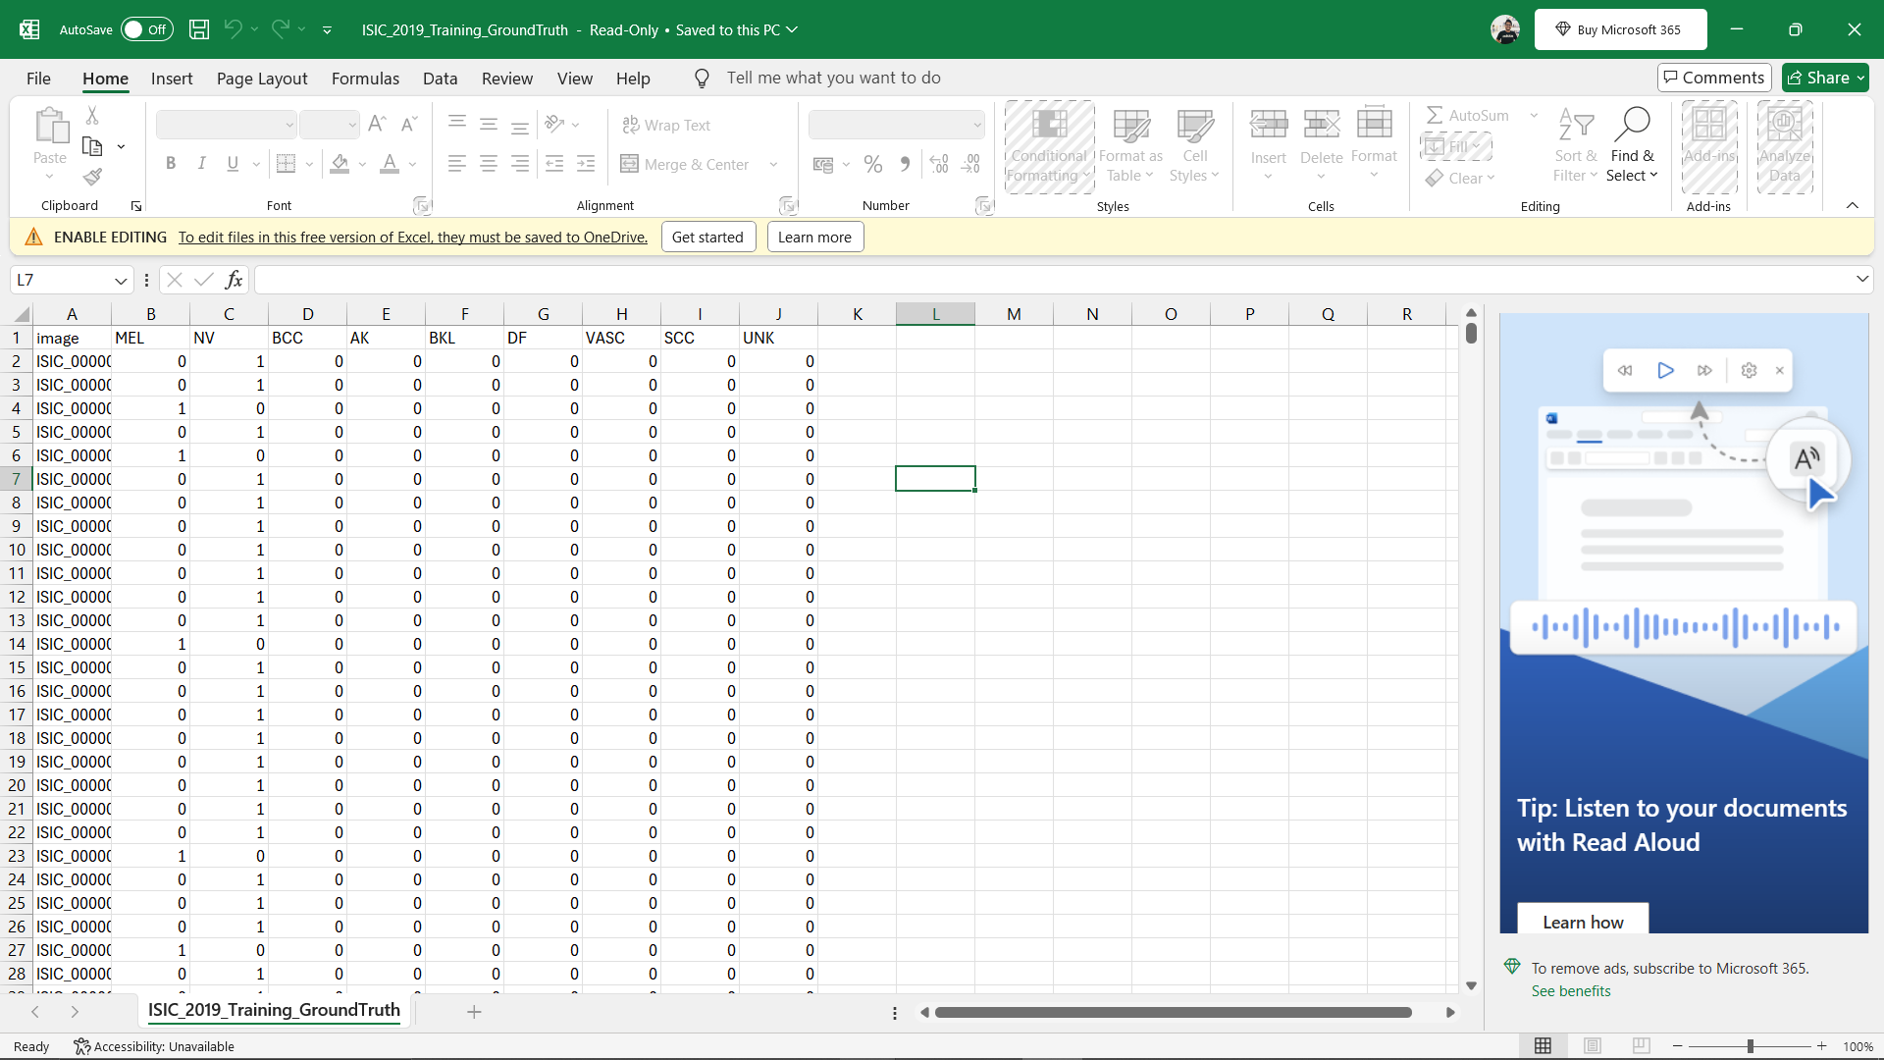
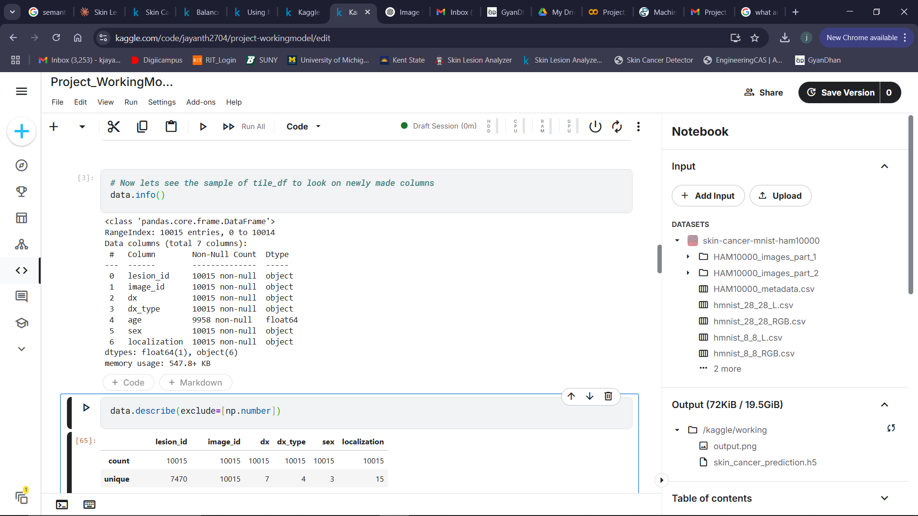
Column/Feature Details

Slide 17
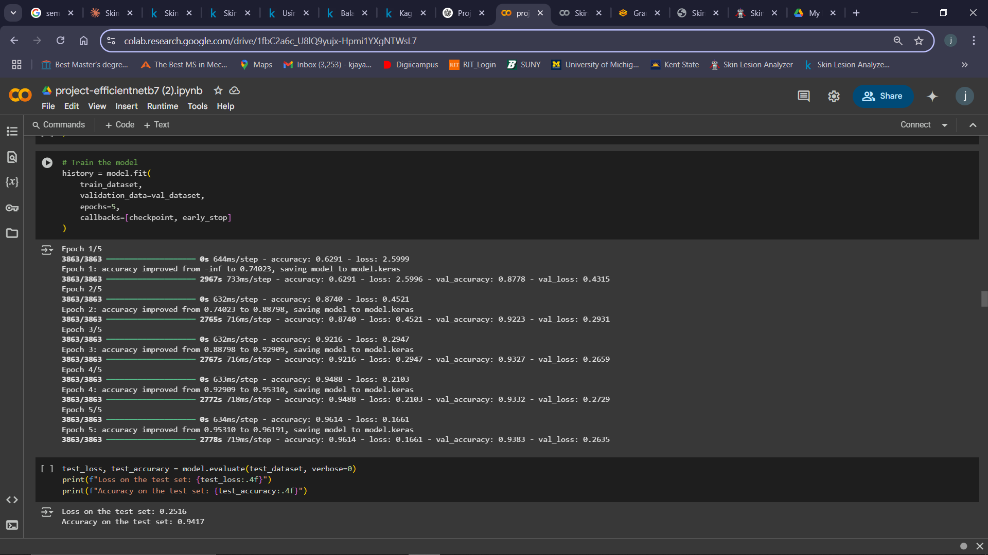
Results and Discussion
EfficientNetB7

Slide 18
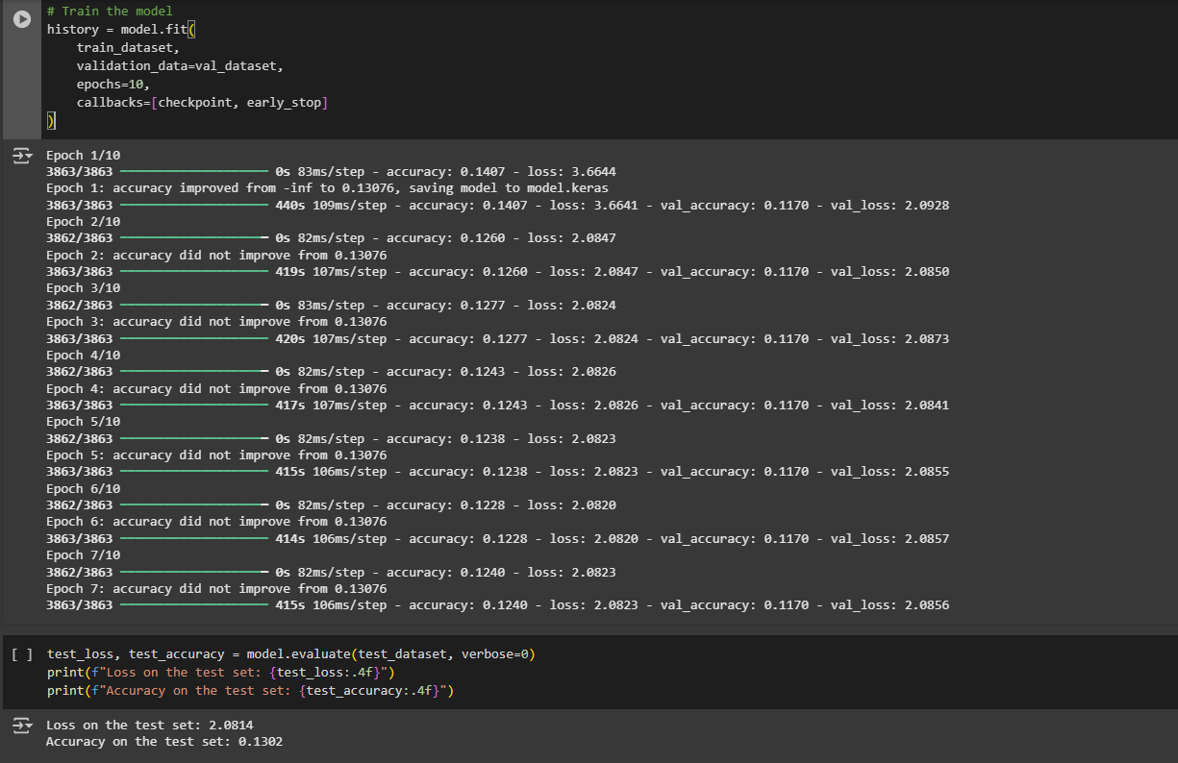
ResNet50
18

Slide 19
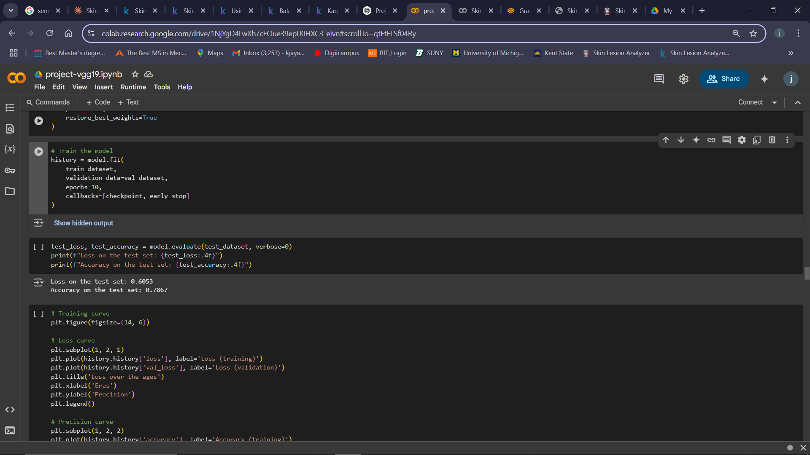
VGG19
19

Slide 20
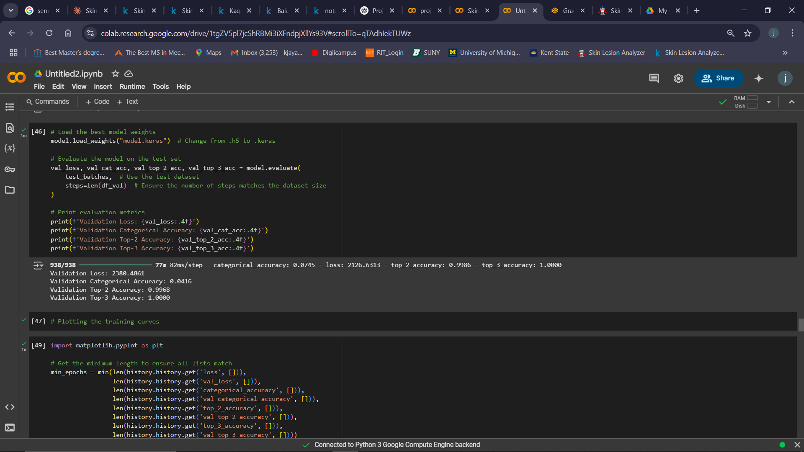
MobileNet
20

Slide 21
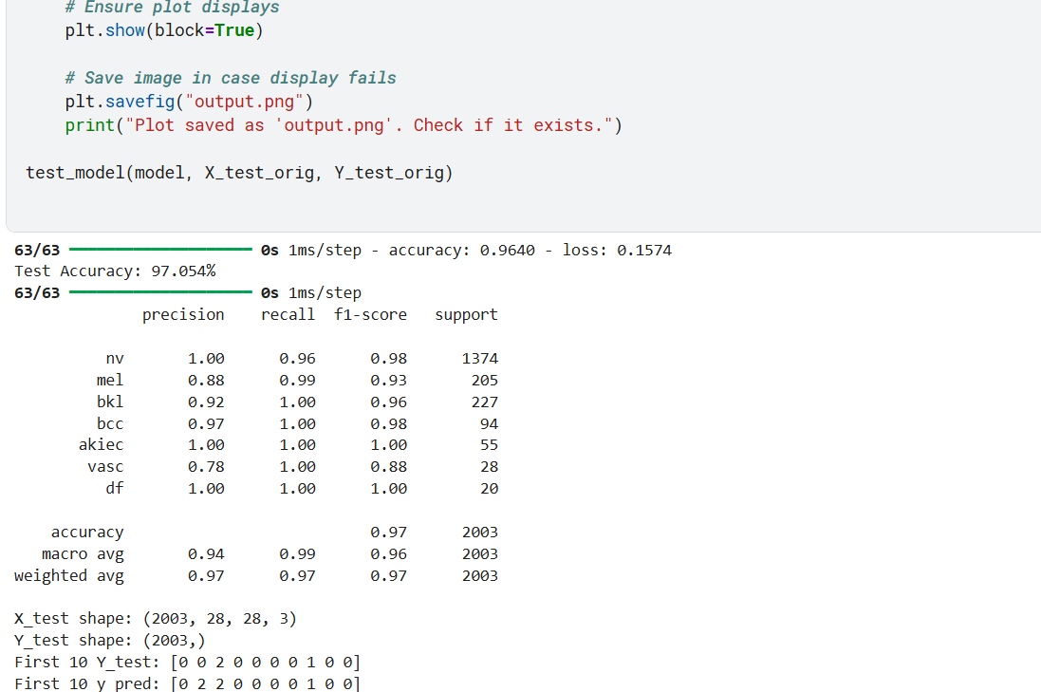
Custom CNN

Slide 22
Performance Analysis
Models | Accuracy
EfficientNetB7 | 94.17%
ResNet50 | 13.02%
VGG19 | 78.67%
MobileNet | 99.68%
Custom CNN | 97.05%

Slide 23
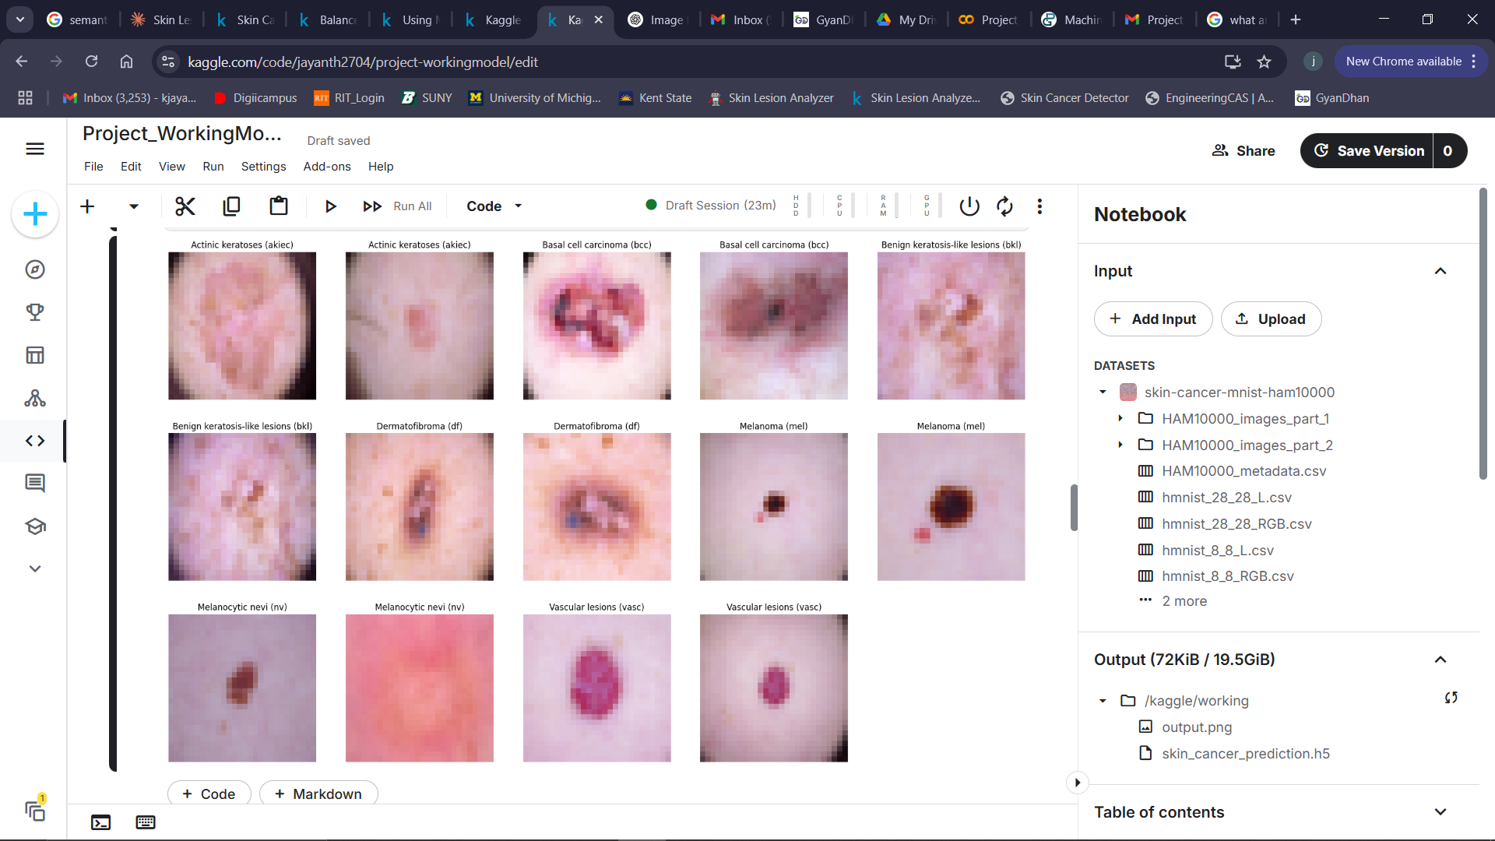
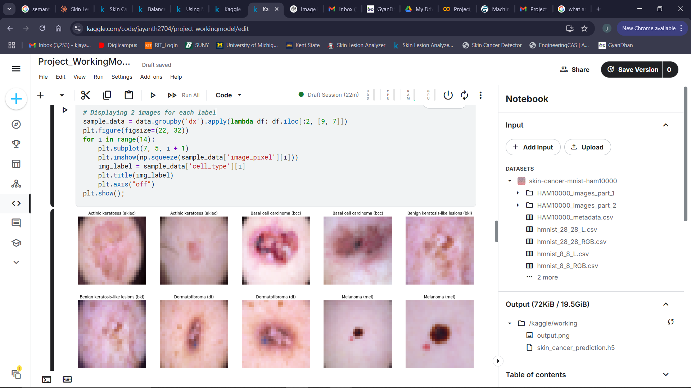
Images before Data Augmentation

Slide 24
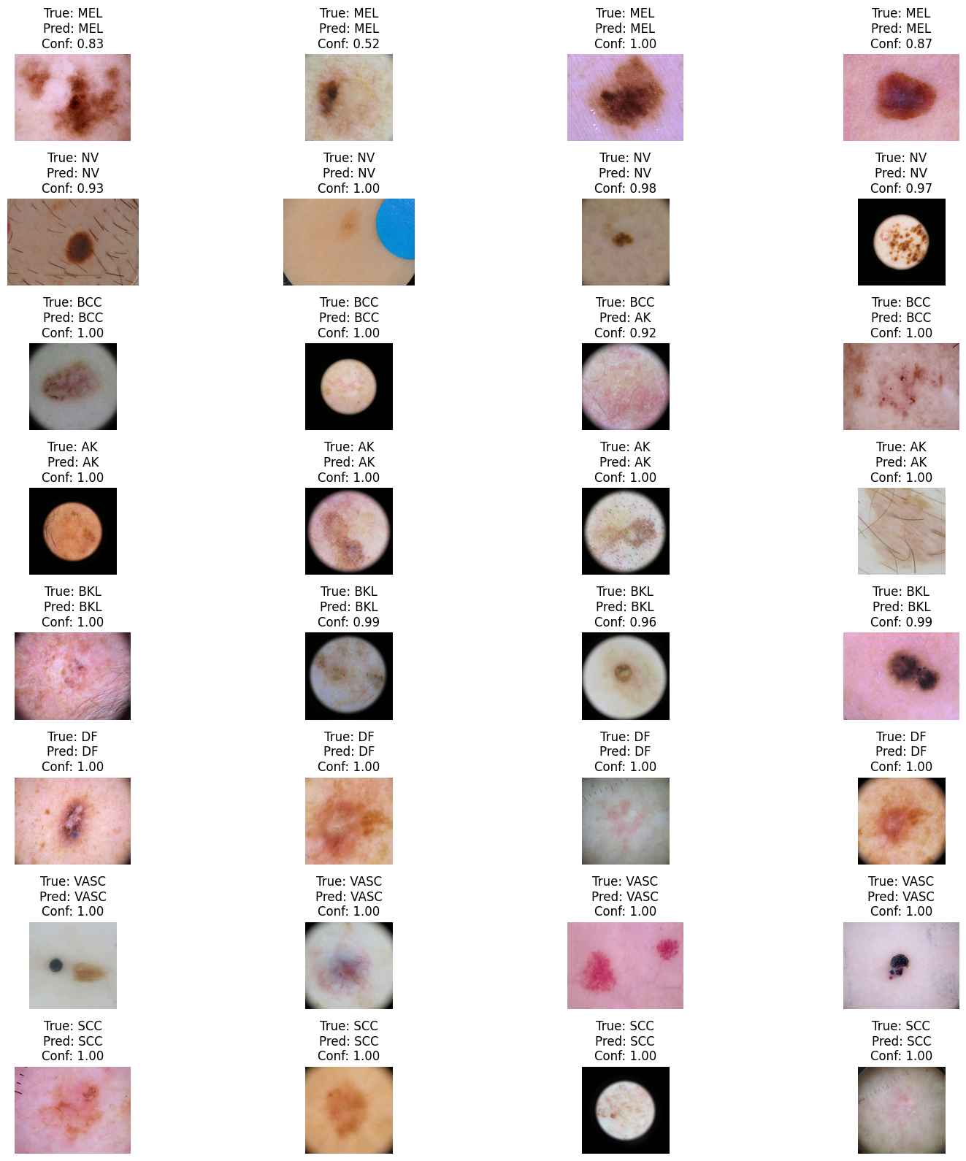
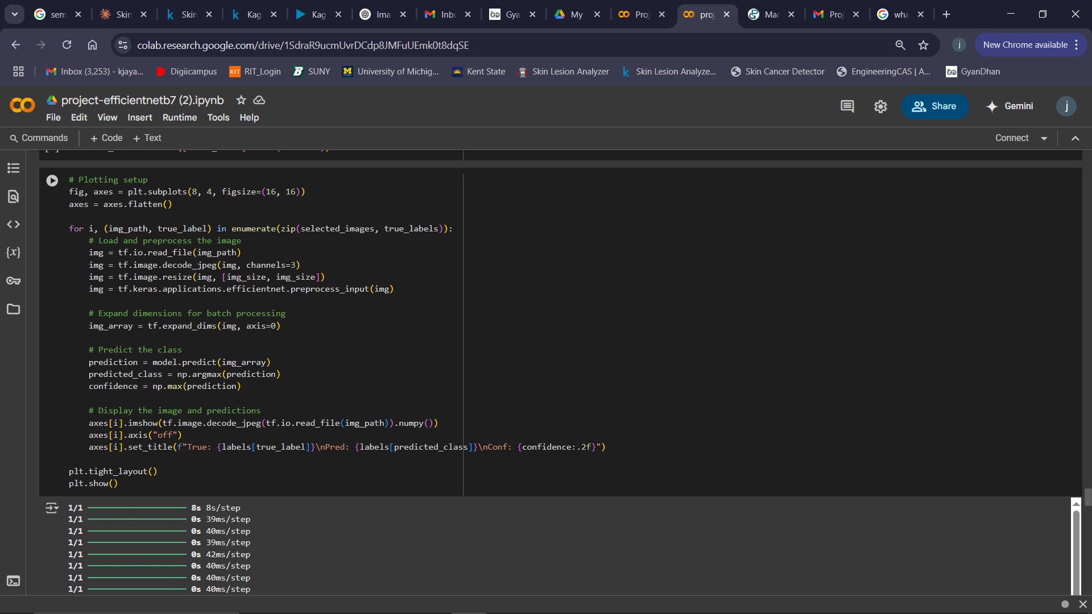
Images after Data Augmentation

Slide 25
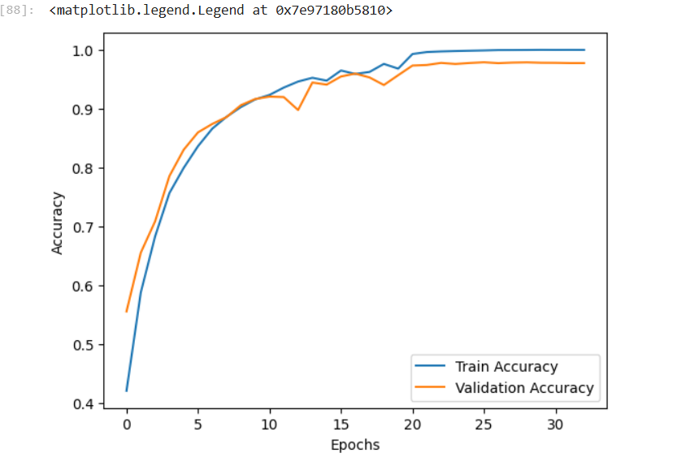
Accuracy Curve

Slide 26
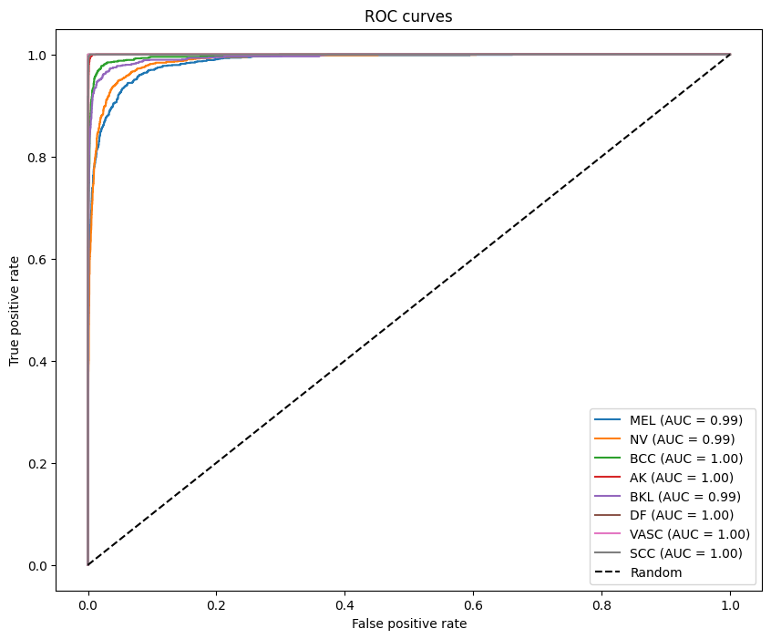
ROC Curve

Slide 27
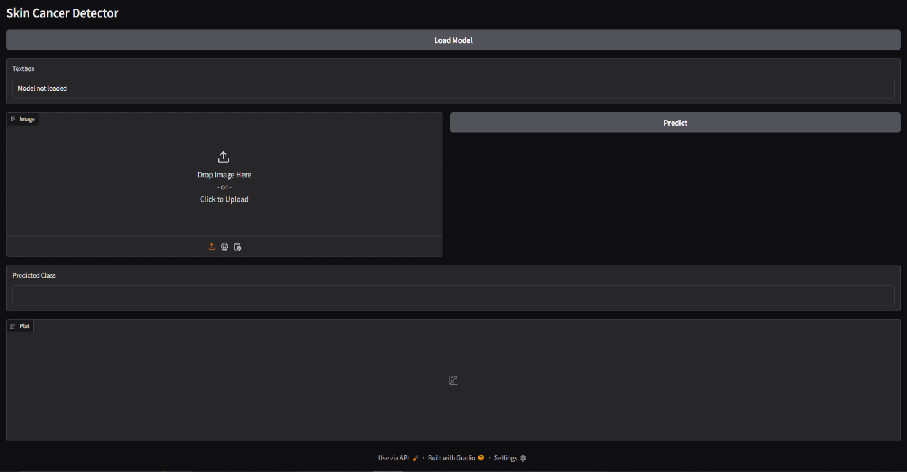
User Interface of Gradio web application

Slide 28
Conclusion
This project aims to develop an advanced deep learning-based skin cancer classification system using Convolutional Neural Networks (CNNs) to accurately detect and classify skin lesions from medical images. By leveraging transfer learning with EfficientNet or ResNet, addressing class imbalance, and implementing robust evaluation metrics, this system will enhance early melanoma detection and assist dermatologists in making more informed decisions.
To ensure accessibility and usability, the trained model will be integrated into a user-friendly application that allows users to upload images for instant classification. This app will provide an efficient, scalable, and accurate solution for automated skin cancer diagnosis, with potential future enhancements such as mobile deployment, explainable AI features, and real-time clinical integration.
Ultimately, this project has the potential to contribute to early detection, improved diagnosis, and better patient outcomes, making a significant impact in the field of medical AI and dermatology.

Slide 29
Future Enhancement
1. Optimize Deployment
Convert Model to TensorFlow Lite (TFLite): Deploy on mobile devices for real-time inference.
Use ONNX Format: Make the model interoperable with different frameworks like PyTorch and OpenVINO.
Optimize for Cloud Deployment: Deploy on AWS, Google Cloud, or Azure for large-scale use.
2. Enhance User Experience in Gradio Web App
Add Heatmap Visualization: Use Grad-CAM to highlight lesion areas contributing to the prediction.
Enable Multi-Image Uploads: Allow batch processing of multiple images.
Provide Explanations: Integrate LIME or SHAP to explain model decisions.
3. Integrate with Medical Databases
Real-Time Database Connectivity: Store patient records securely for future reference.
Electronic Health Record (EHR) Integration: Connect with hospital databases for easy access by dermatologists.
4. Expand Classification Scope
Detect Other Skin Conditions: Extend the model to classify acne, psoriasis, and other common skin diseases.
Incorporate Multi-Class or Multi-Label Classification: Allow multiple conditions to be detected in a single image.
5. Regulatory Compliance and Certification
Ensure Model Fairness: Test on diverse datasets to avoid biases.
FDA/CE Certification: Work towards making the model usable in real-world clinical applications.

Slide 30
References
Base Paper:
Nils Gessert, Maximilian Nielsen, Mohsin Shaikh, Rene Wener, Alexander Schlaefer (2020), “Skin Lesion classification using ensembles of multi-resolution EfficientNets with meta data” in Elsevier
DOI: https://doi.org/10.1016/j.mex.2020.100864
Related Papers:
Bhuvaneshwari Shetty , Roshan Fernandes , Anisha P. Rodrigues , Rajeswari Chengoden ,Sweta Bhattacharya & Kuruva Lakshmanna (2022), “Skin lesion classification of dermoscopic images using machine learning and convolutional neural network”, Sci Rep 12, 18134.
DOI: https://doi.org/10.1038/s41598-022-22644-9
Thwin, S. M., & Park, H.-S. (2024). Skin Lesion Classification Using a Deep Ensemble Model. Applied Sciences, 14(13), 5599.
DOI: https://doi.org/10.3390/app14135599
A. Afroz, R. Zia, A. O. Garcia, M. U. Khan, U. Jilani and K. M. Ahmed (2022) "Skin lesion classification using machine learning approach: A survey," 2022 Global Conference on Wireless and Optical Technologies (GCWOT), Malaga, Spain, 2022, pp. 1-8
DOI: 10.1109/GCWOT53057.2022.9772915.

